Slide 1

Resilience Efforts in India
US-India Partnership for Climate Resilience
Workshop on Development & Application of Downscaling Climate Projections
7-9. March 2017
IITM Pune
Nambi Appadurai. Ph.D
Strategy Head (Climate Resilience Practice)
World Resources Institute
Nappadurai@wri.org

Slide 2
Outline
Impacts & Consequences
Resilient Building Measures
Looking Ahead
Nambi Appadurai

Slide 3

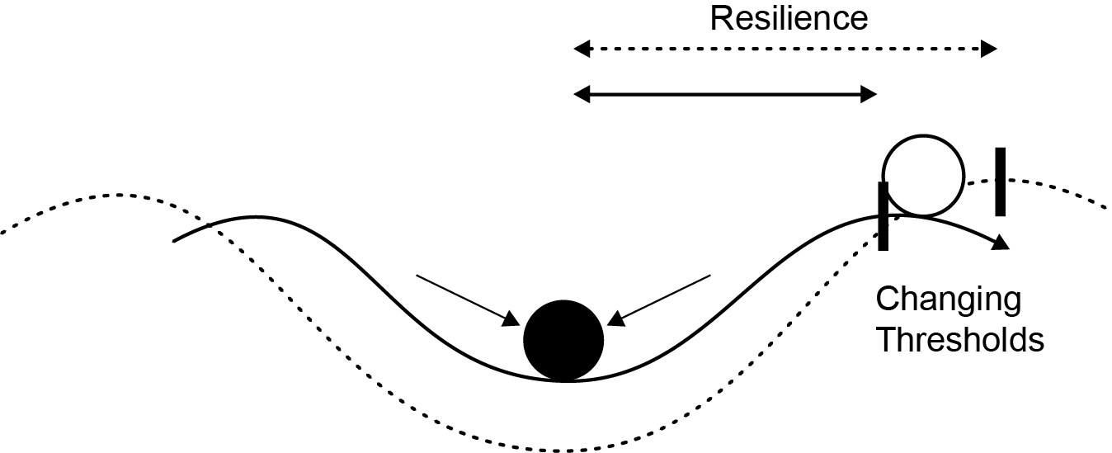
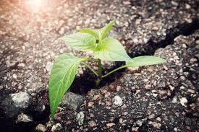
Why focus on resilience?
Risk perceived increasing in both frequency and intensity
Resilience perceived as a process of reconciling humanitarian response to disasters with longer-term development efforts.
Growing understanding and recognition of interdependence between biophysical and socioeconomic systems.
Nambi Appadurai

Slide 4
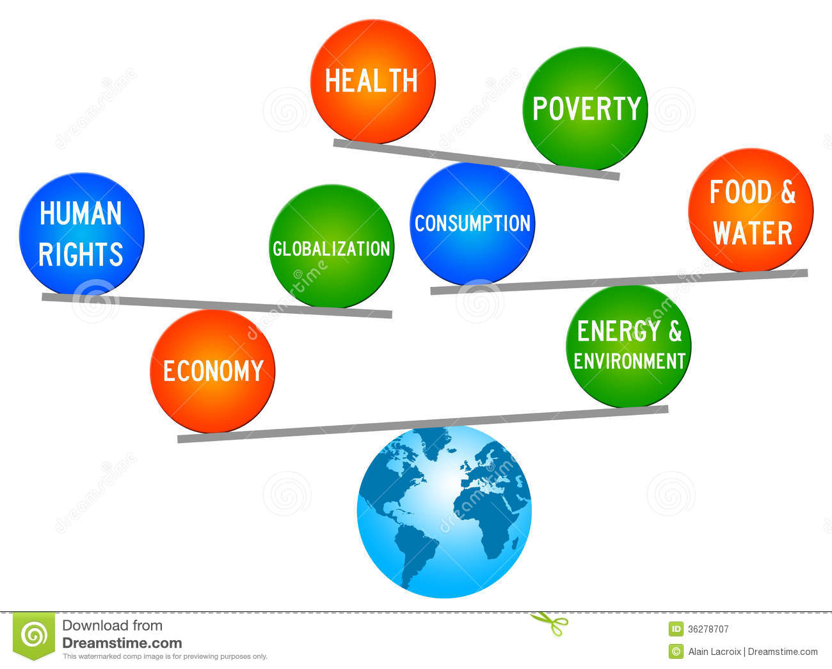
Primary Drivers of Vulnerability
Climate Change
Population Growth
Poverty
Urbanization
Globalization
Conflicts & terrorism
Nambi Appadurai

Slide 5
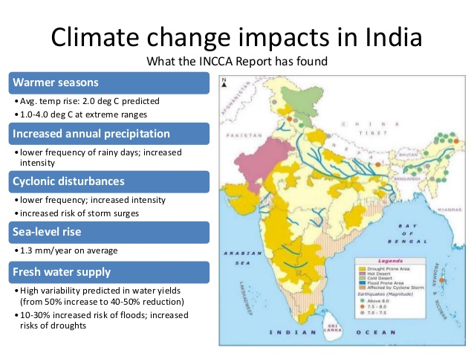
Climate Variations & Change
More than 60% of population depends on climate sensitive sectors, e.g. agriculture and forestry
Temperature increases
- Observed: 0.4°C over past 100 yrs.
- Projected: ~ 2 °C by 2030.
Precipitation will be me more variable, e.g. changes in monsoon patterns
Increase in both intensity & frequency of extreme events: droughts, floods, cyclones
Nambi Appadurai

Slide 6
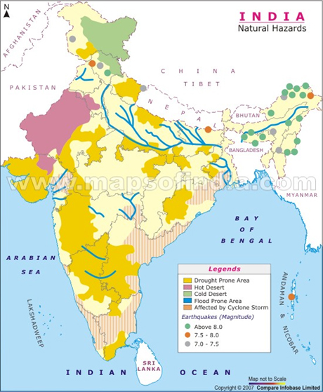
Disasters- Indian Scenario
India supports 1/6th of world’s population on
2 % of world's landmass
59% of land vulnerable to earthquakes
28% of land vulnerable to drought
68% of cultivable lands are vulnerable to droughts
40 million hectares (12%) of land vulnerable
to floods
80% of coast vulnerable to Cyclones
1 million houses damaged annually leading to human, economic, social and other losses
Nambi Appadurai

Slide 7
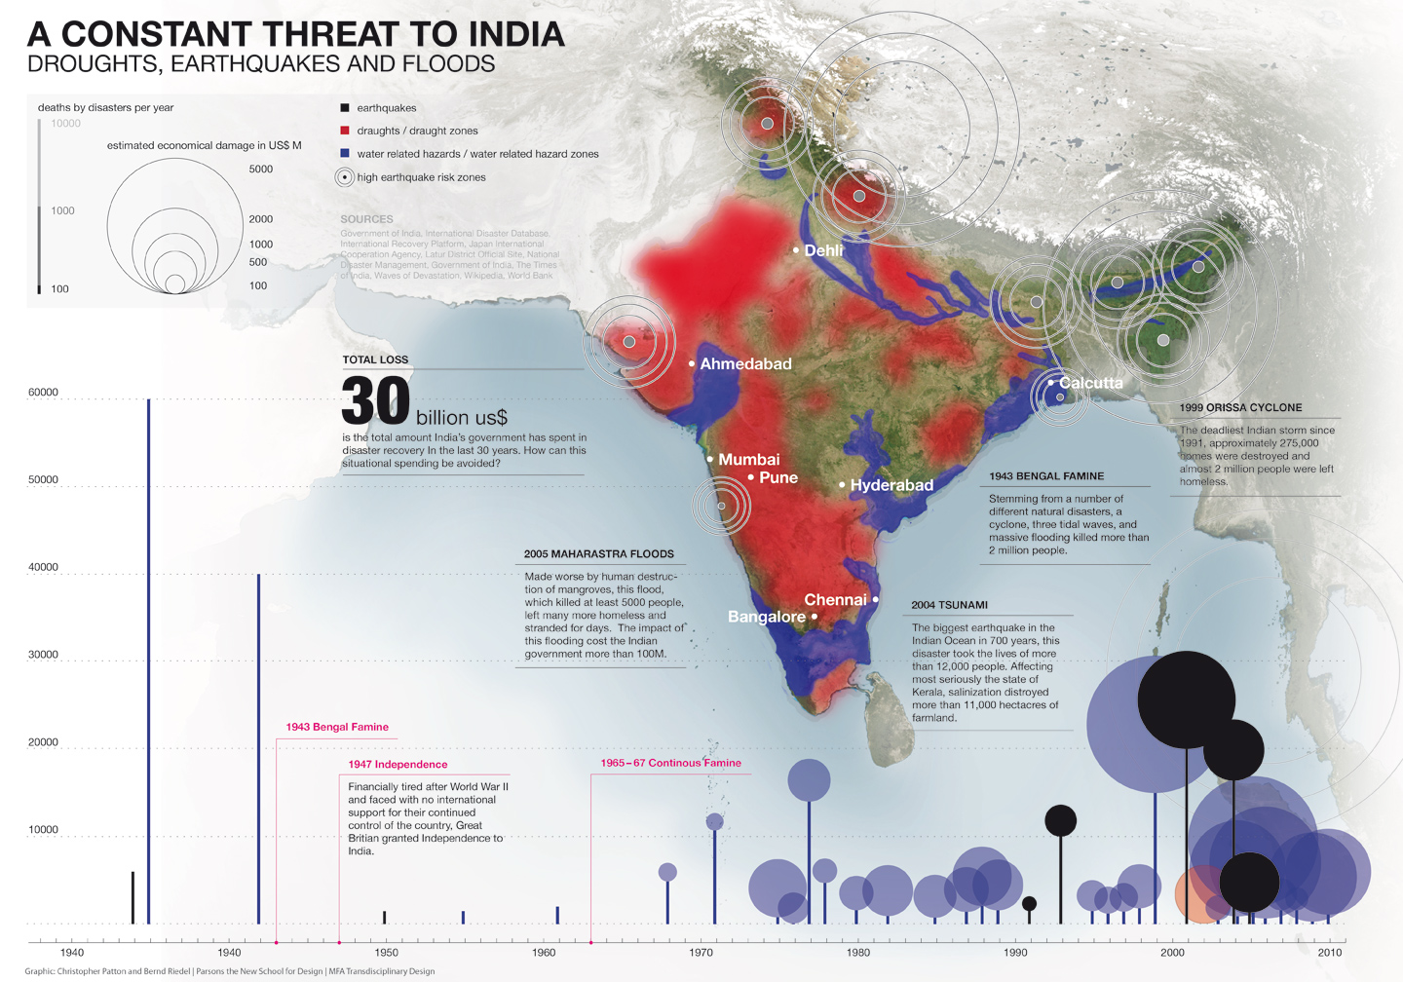
http://indiaenvironmentportal.org.in/media/iep/infographics/2015%20Floods/tracker.html
Nambi Appadurai

Slide 8
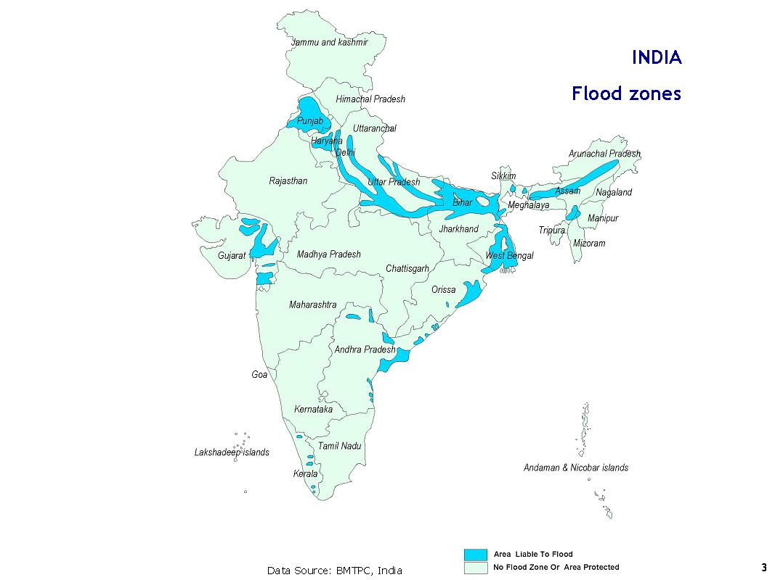
Floods
About 30 million people are affected annually. Floods in the Indo–Gangetic–Brahmaputra plains are an annual feature.
On an average, a few hundred lives are lost, millions are rendered homeless and several hectares of crops are damaged every year.
Nearly 75% of the total rainfall occurs over a short monsoon season (June – September). 40 million hectares, or 12% of Indian land, is considered prone to floods.
Floods are a perennial phenomenon in at least 5 states - Assam, Bihar, Orissa , Uttar Pradesh and West Bengal.
Source: NDMA, 2011
Nambi Appadurai

Slide 9
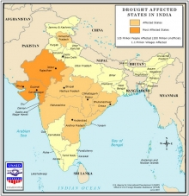
Droughts
Drought is another recurrent phenomenon which results in widespread adverse impact on vulnerable people’s livelihoods and young children’s nutrition status.
About 50 million people are affected annually by drought. Of approximately 90 million hectares of rain-fed areas, about 40 million hectares are affected by scanty or no rain.
Though droughts are slow onset emergency, and to an extent predictable emergency, they have caused severe suffering in the affected areas exacerbating poverty, hunger and unemployment
Nambi Appadurai

Slide 10
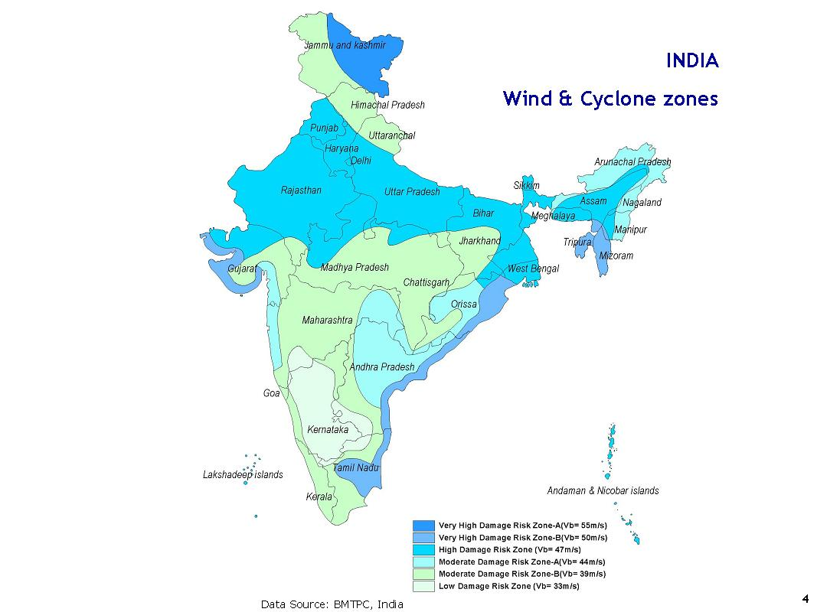
Cyclones
About 8% of the land is vulnerable to cyclones of which coastal areas experience two or three tropical cyclones of varying intensity each year.
Cyclonic activities on the east coast are more severe than on the west coast.
The Indian continent is considered to be the worst cyclone-affected part of the world, as a result of low-depth Ocean-bed topography and coastal configuration.
The principal threat from a cyclone are in the form of gales and strong winds; torrential rain and high tidal waves and storm surges
More cyclones occur in the Bay of Bengal than in the Arabian Sea and the ratio is approximately 4:1.
Nambi Appadurai

Slide 11
Projected Coastal Impacts
  Coastal Zone
    About 7516 Kms of coastline
    Population density of 455 pers /Km², 1.5 times national average of 324 pers/ Km²
    Sea level rise highest along Gulf of Kutch/ coast of West Bengal
    1m Sea Level Rise
      - will displace aprox 7.1 million people, about 5,764 Km² of land area will be lost and damage 4200 km of road network
Nambi Appadurai

Slide 12
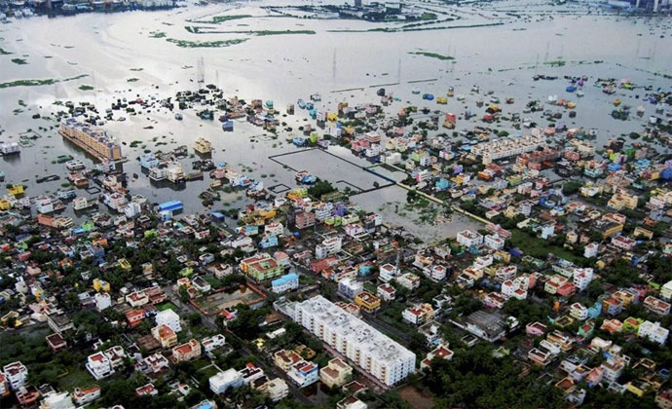
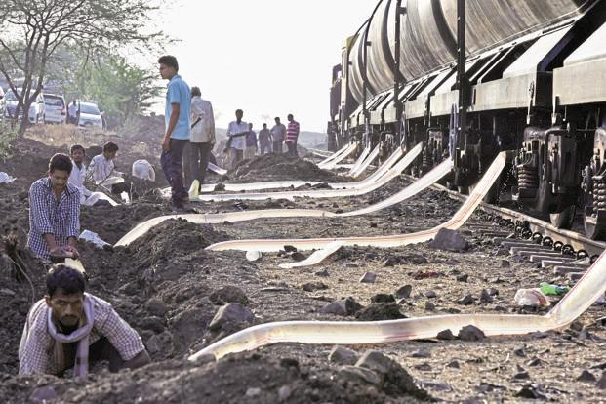
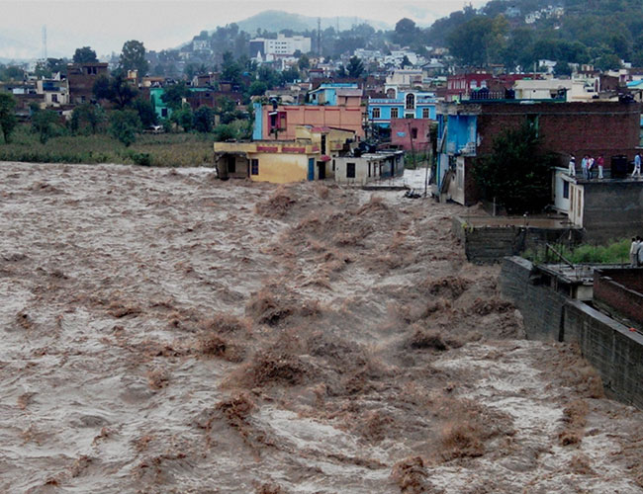
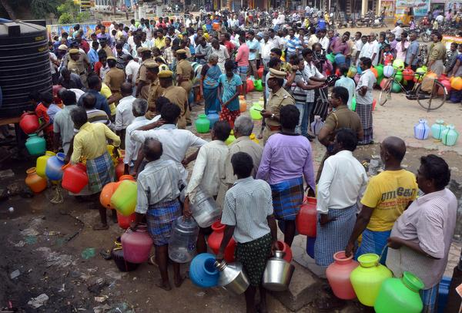
India – last two years
Chennai floods
Latur Drought
J&K floods
Karnataka drought
Chennai – DailyO, Latur – Livemint, J&K- Indiatoday, Karnataka- TheHindu

Slide 13
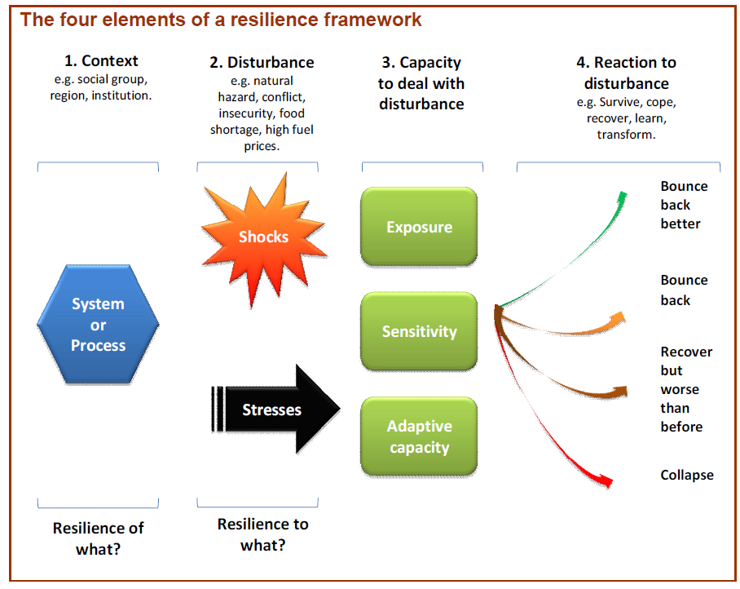
Resilience Framework
Nambi Appadurai

Slide 14
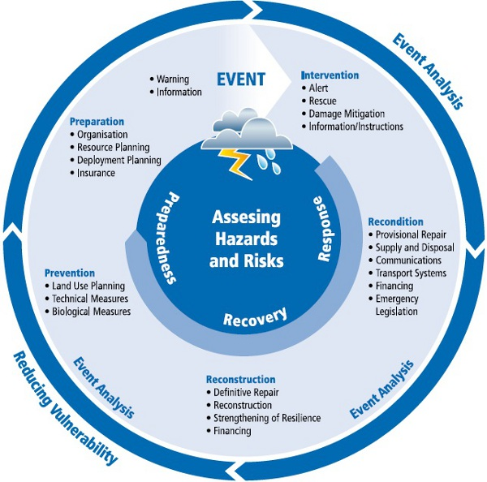
Resilience Options
Nambi Appadurai

Slide 15
Keys to Managing Risk
Assessing vulnerability
Understanding climatic sensitivities and critical thresholds
Characterizing adaptive capacity
Engage decision makers
Integrating risks due to climate change into on-going decision making processes
Nambi Appadurai

Slide 16
India’s Climate Resilience Framework
National, state and local government initiative to:
- help jurisdictions develop individual resilience strategies
- identify areas where jurisdictions can work together
Framework defines three broad needs
  To build knowledge and understanding
  To increase awareness and engagement
  To build capacity to undertake / implement action
Nambi Appadurai

Slide 17
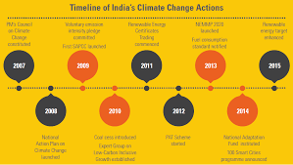
Resilience Building Initiatives
National Action Plan on Climate Change (NAPCC)
  National Solar Mission
  National Mission for Enhanced Energy Efficiency
  National Mission on Sustainable Habitat
  National Water Mission
  National Mission for Sustaining the Himalayan Ecosystem
  National Mission for a “Green India”
  National Mission for Sustainable Agriculture
  National Mission on Strategic Knowledge for Climate Change
State Action Plan on Climate Change (SAPCC) – 30 states
National Adaptation Fund for Climate Change with an initial allocation of INR 3,500 million (USD 55.6 million)
Urban
  Jawaharlal Nehru National Urban Renewal Mission
  Urban Infrastructure Development Scheme for Small and Medium Towns (UIDSSMT)
  Climate proofing of Infrastructure
  100 Resilient cities
Nambi Appadurai

Slide 18
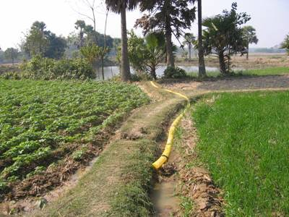
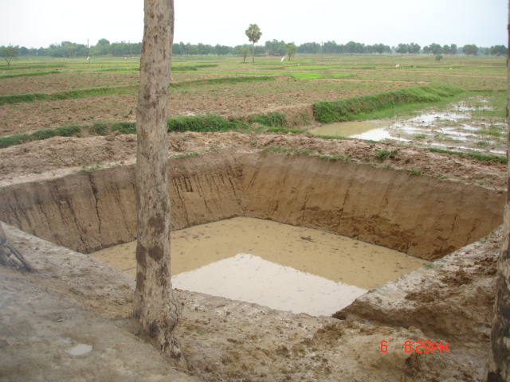
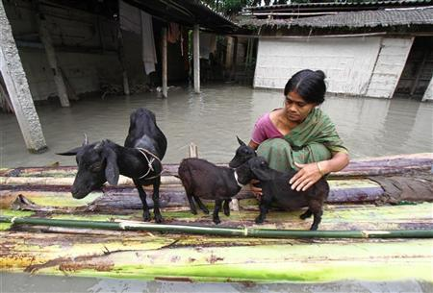
Resilience Building Initiatives
Rural
  Integrated adaptation in national schemes like MGNREGS
  National Initiative on Climate Resilient Agriculture (NICRA)
  National Agroforestry Policy (NAP)
  National Mission for Clean Ganga
  Watershed Management Projects
  Afforestation programs
  Climate proofed Infrastructure (roads, ports, check dams)
  Weather based Insurance
Fiscal Instruments
  Taxes on fossil fuels, coal cess
  Tax free Infrastructure bonds
  Incentives for creation of carbon sinks
Health
  Integrated Disease Surveillance Programme (IDSP)
  National Vector Borne Disease Control Programme (NVBDCP)
Integrated Coastal Zone Management
National and State Disaster Management Authority
Nambi Appadurai

Slide 19
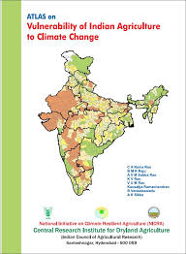
National Initiative for Climate Resilient Agriculture (NICRA)
Agricultural vulnerability atlas for India (2013)
Integrated watershed management approach
Climate & crop Modelling
Agro advisories based on meteorology
Climate information services
Agronomic interventions
Integrated farm management
Training & capacity building
Research & development
Nambi Appadurai

Slide 20
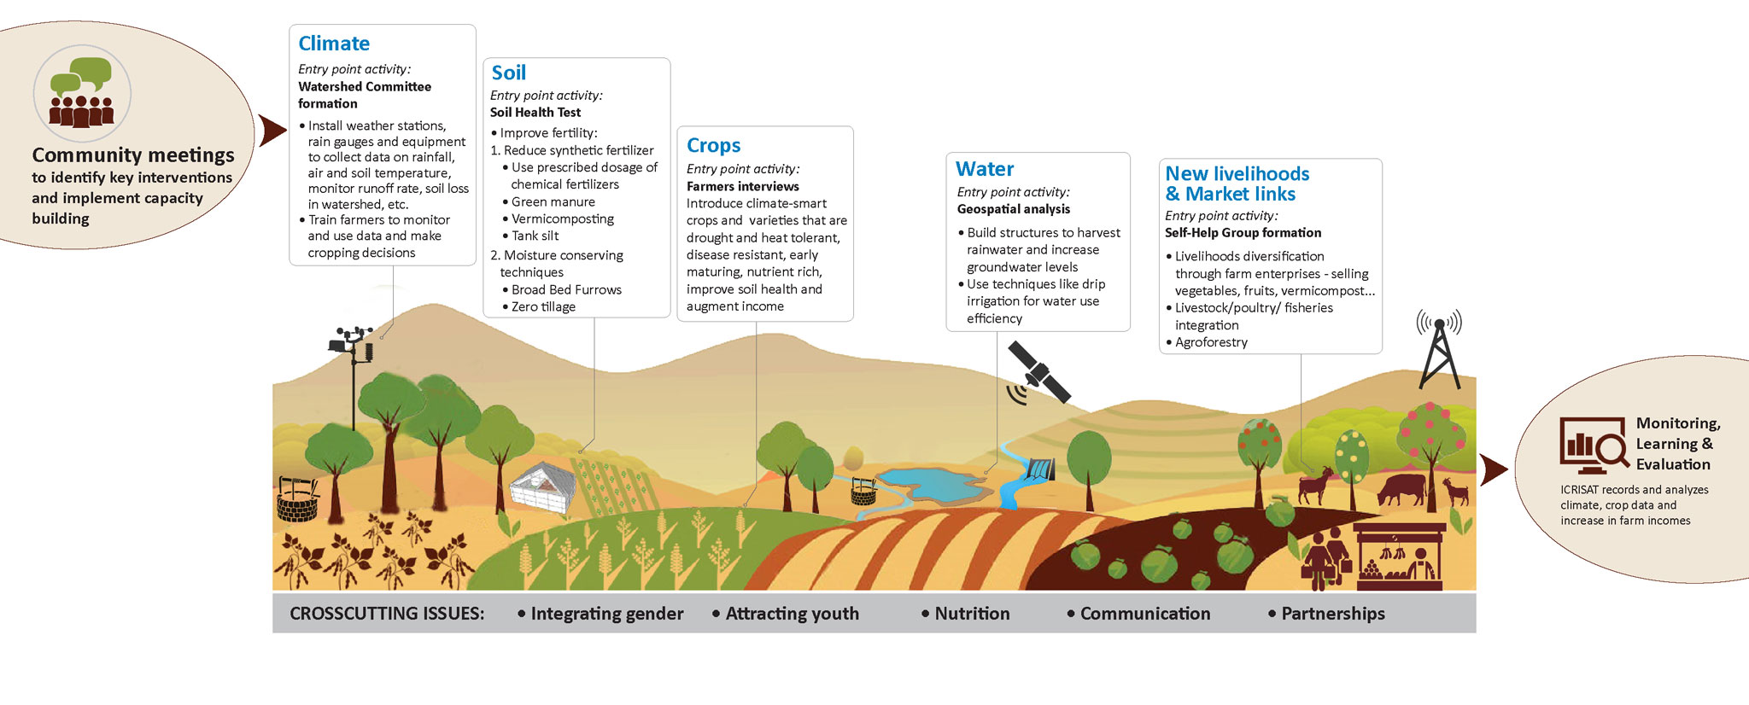
CCAFS - Community Oriented Approaches
IWMI, 2012
Nambi Appadurai

Slide 21
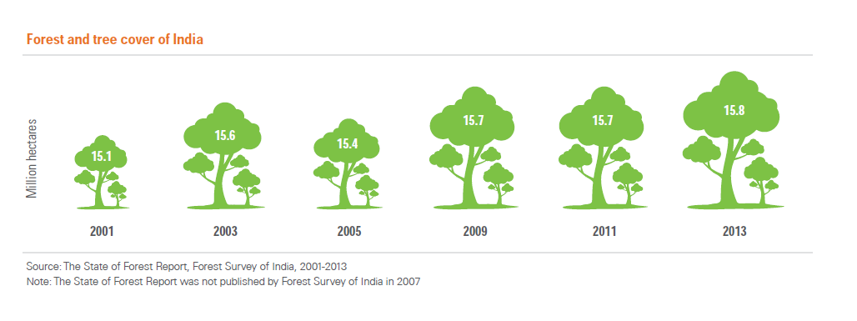
Forestry
Nambi Appadurai

Slide 22
Urban Resilience
Urban areas in India contribute to 60% of GDP. Expected grow by 70% by 2030
About 70% of urban infrastructure is yet to be built in India. Huge opportunity for integrating resilience in future infrastructure development.
Smart Cities Initiative (green infrastructure, energy efficiency, water conservation, waste management, sustainable transport systems)
City specific vision documents
Nambi Appadurai

Slide 23
Key Constraints
Inadequate Capacity
Outdated acts & regulations
Data quality and access
Information flow – Moving target
Research
Diversity
Weak Institutions – extension services
Scattered institutional memory
Nambi Appadurai

Slide 24
Resilient Characteristics
India has enough experience in dealing with natural disasters
The lessons that we learnt from the Orissa cyclone of 2000, the Gujarat earthquake of 2001 and the tsunami of 2004 - the major disasters have helped us effect a paradigm shift in our approach to disaster management and building resilience
Social capital is the biggest asset
Rich traditional knowledge
Advancement in science & technology
Nambi Appadurai

Slide 25
Looking ahead
Promote evidence based research
Transformative approaches
Sound M&E
Leveraging low-carbon technologies
Knowledge sharing (best practices, tools & methods)
Improved access to climate information
Information support for decision making
About 70% of urban infrastructure is yet to be built in India. Provides a big window of opportunity to build climate resilient infrastructure.
Focus on peri-urban development
Nambi Appadurai

Slide 26

THANK YOU
Nambi Appadurai

